Slide 1
CAP446:DATA WAREHOUSING AND DATA MINING
(Course Introduction)

Slide 2

Questions?? Q What is Data warehouse? Q Where we used it? Q Why Data Warehouse is important?

Slide 3
Course Outcomes:
CO1 :: Understand the various concepts of data warehousing like metadata, data mart, summary table, fact data and dimension data.
CO2 :: Analyze the various methods to extract knowledge using data mining techniques.
CO3 :: Apply different data mining methodologies with information systems.
CO4 :: Evaluate the current trends in data mining such as web mining, spatial-temporal mining.

Slide 4
Text Books:
1. DATA MINING: CONCEPTS AND TECHNIQUES by JAWEI HAN, MICHELINE KAMBER AND
JIAN PE, MORGAN KAUFMANN
References:
1. INTRODUCTION TO DATA MINING by PANG-NING TAN , MICHAEL STEINBACH , VIPIN
KUMAR, PEARSON

Slide 5


Slide 6


Slide 7


Slide 8


Slide 9
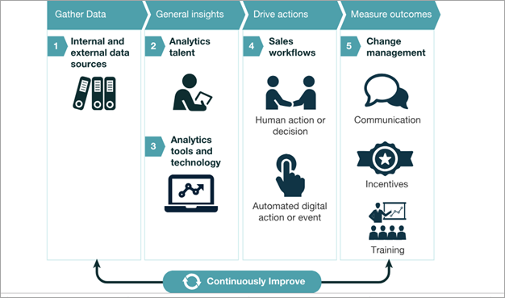

Slide 10
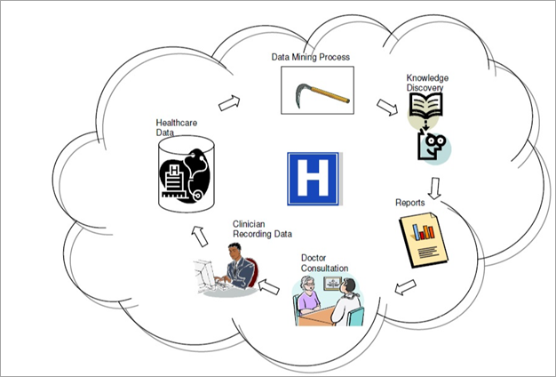
Examples Of Data Mining Applications In Healthcare

Slide 11
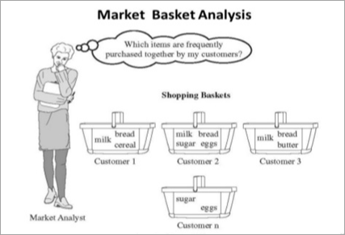

Slide 12
